Slide 1
Daanish Shaikh(QA Manager) Vyom Raj (QA Analyst) Ashraf Pinjari (Business Analyst) Shlok Shah(Software Tester)

Slide 2
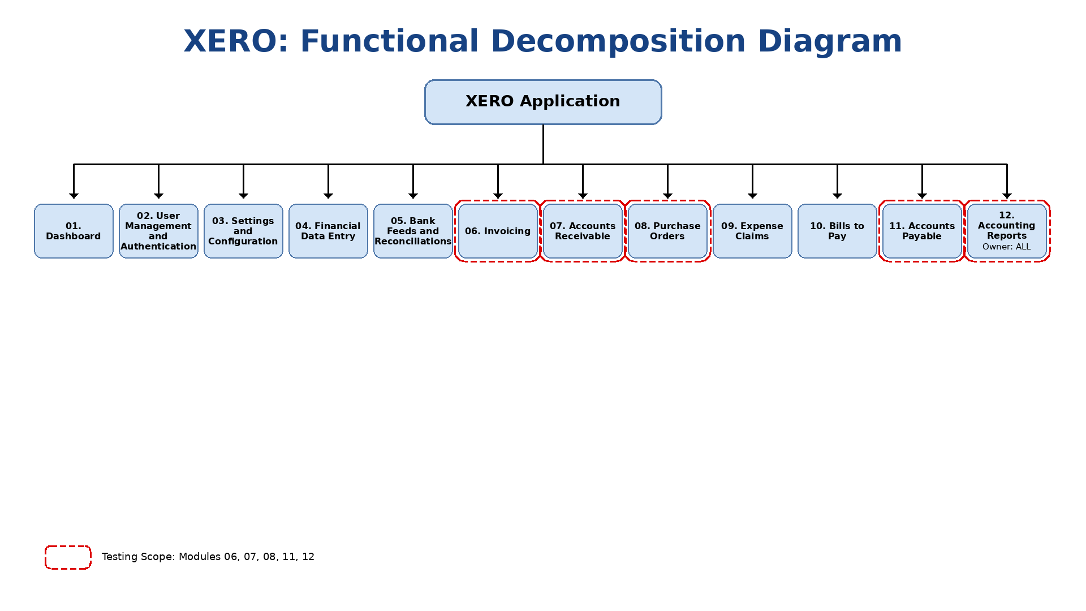
Functional Decomposition Diagram
(presented by Ashraf Pinjari)

Slide 3
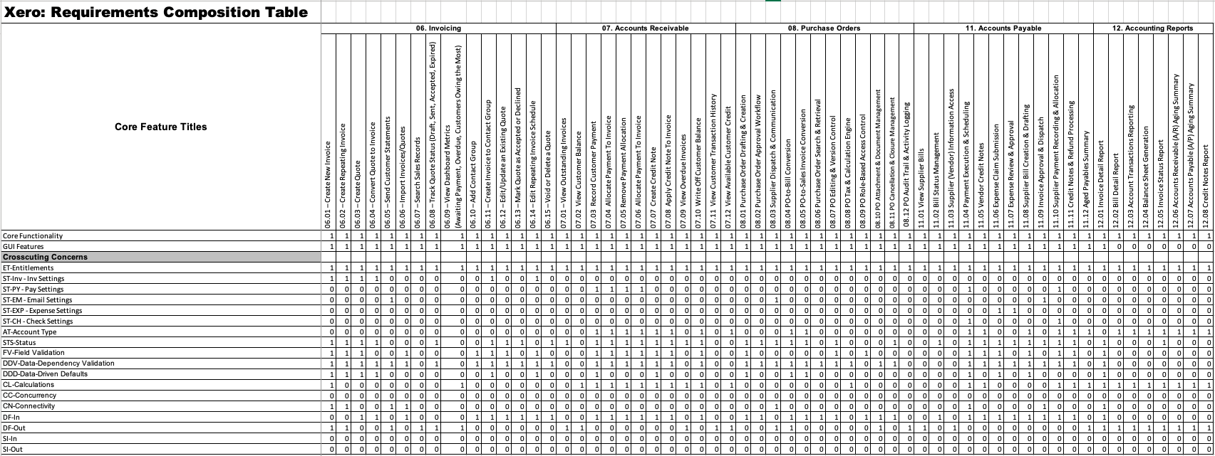
RCT (presented by Ashraf Pinjari)

Slide 4
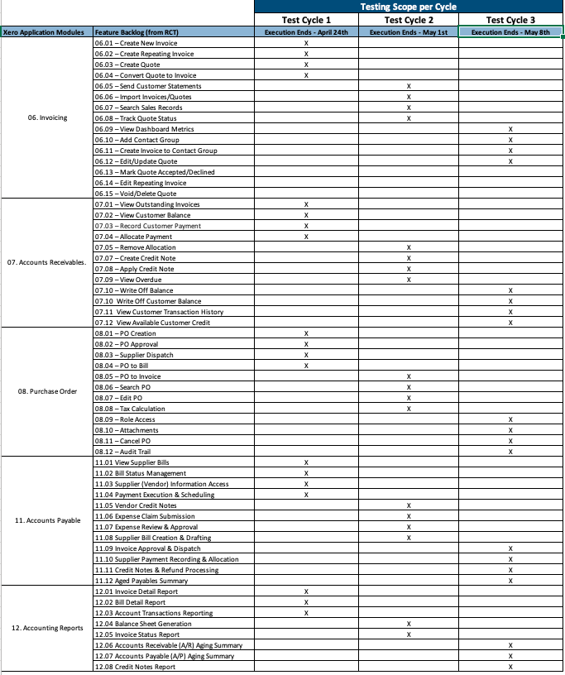
Testing RoadMap
(presented by Shlok Shah)

Slide 5
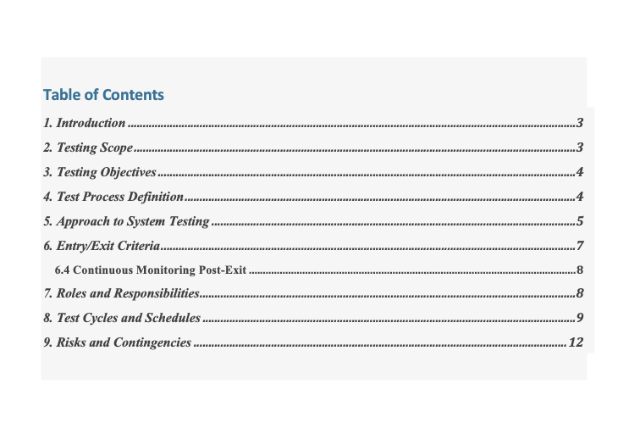
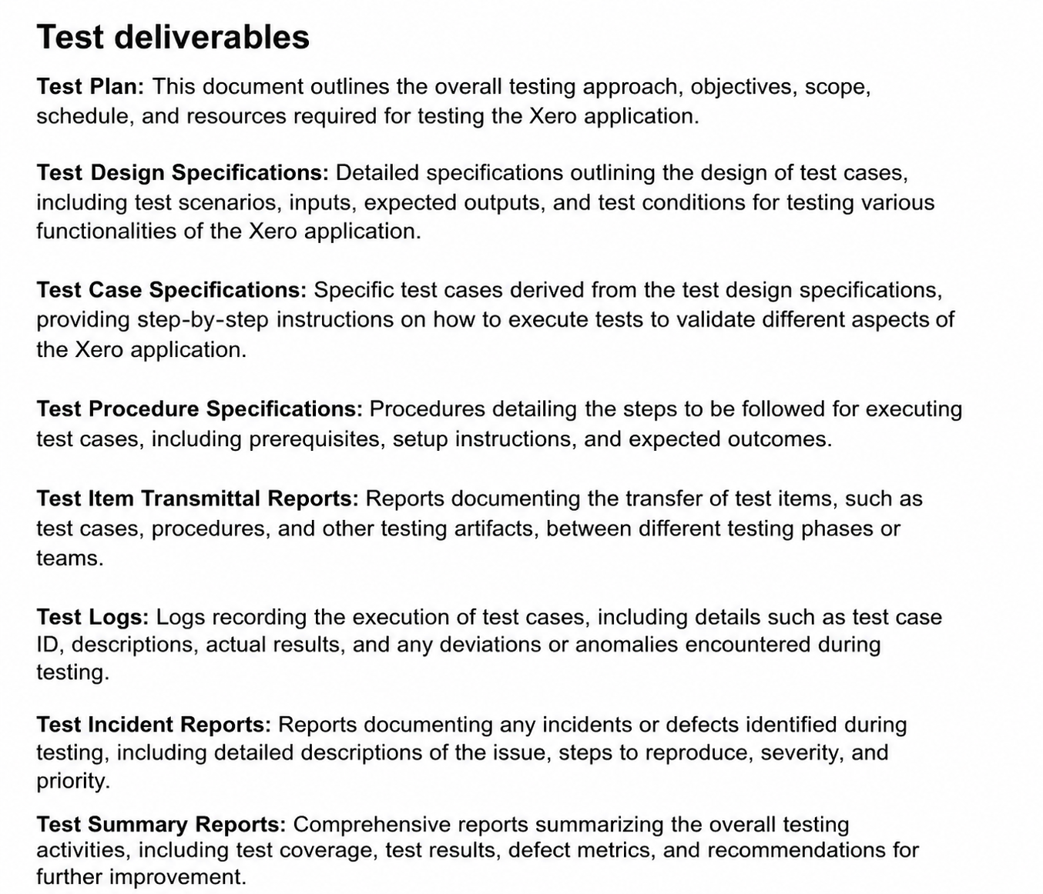
Test Plan
(presented by Shlok Shah)

Slide 6
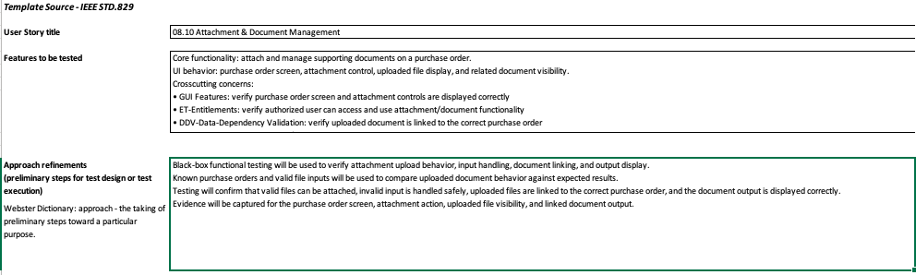
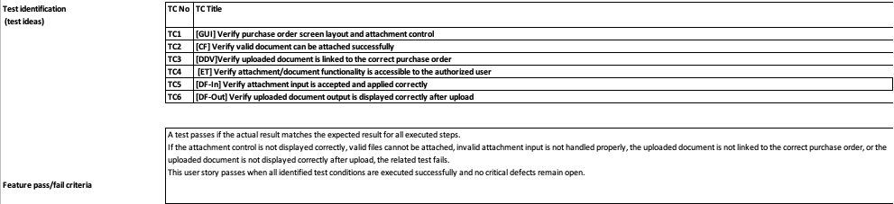
Test Design Specification
(presented by Daanish Shaikh)

Slide 7
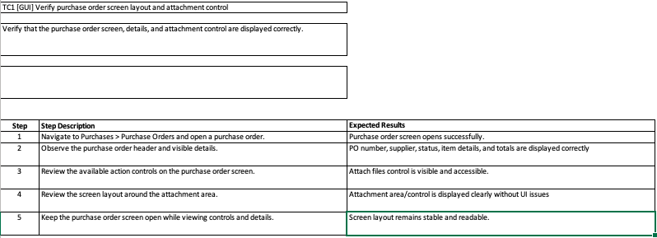
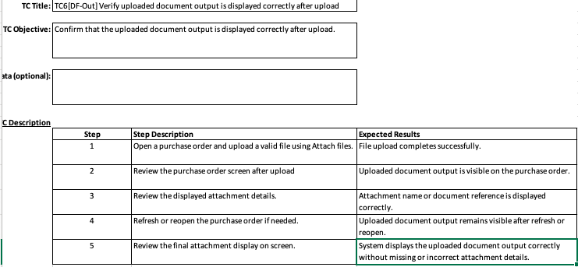
Test Case Specification
(presented by Daanish Shaikh)

Slide 8
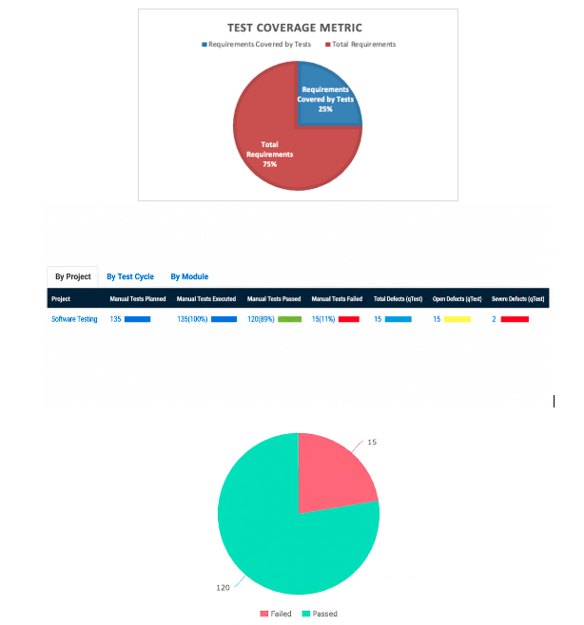
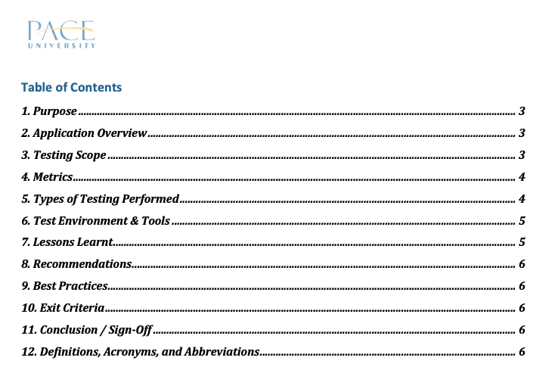
Test Summary Report
(presented by Daanish Shaikh)

Slide 9
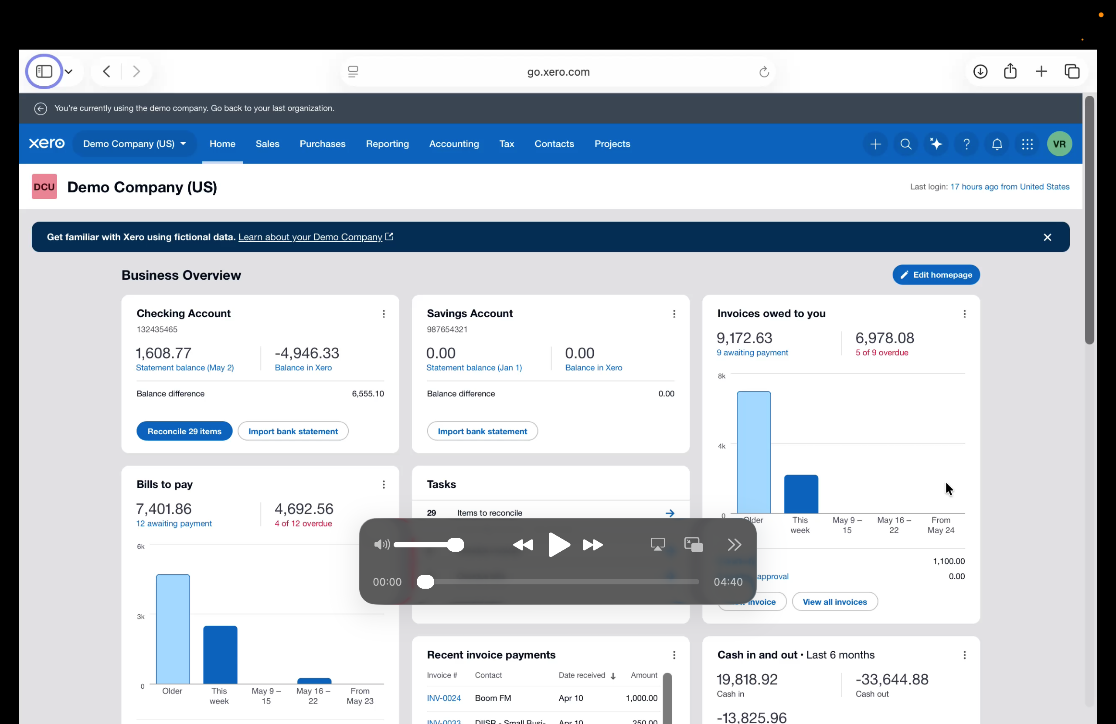
Application Recorded Demo
(presented by Vyom Raj)

Slide 10
Appendix:
GitHub Repository

Slide 11
GitHub Repo Link
https://github.com/shlok695/XERO-Test_Suite

Slide 12


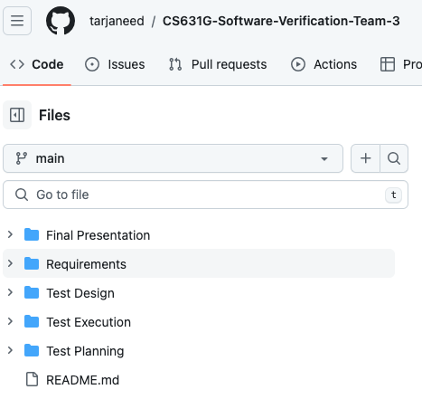

GitHub Repo Folder Structure
Requirements
Test Planning
Test Design
Test Execution
Final Presentation
README.md

Slide 13
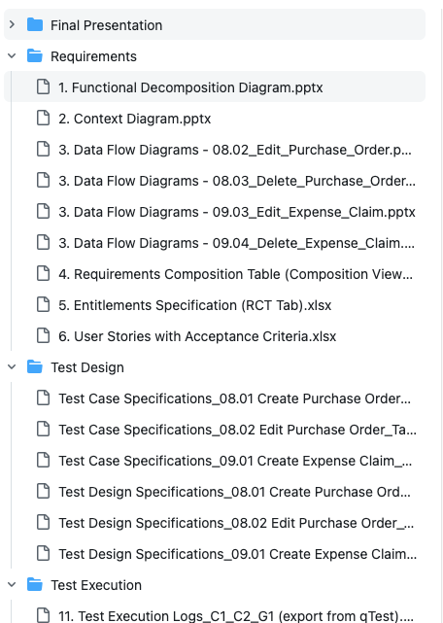
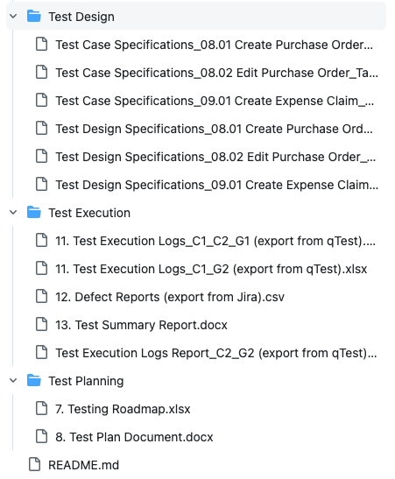
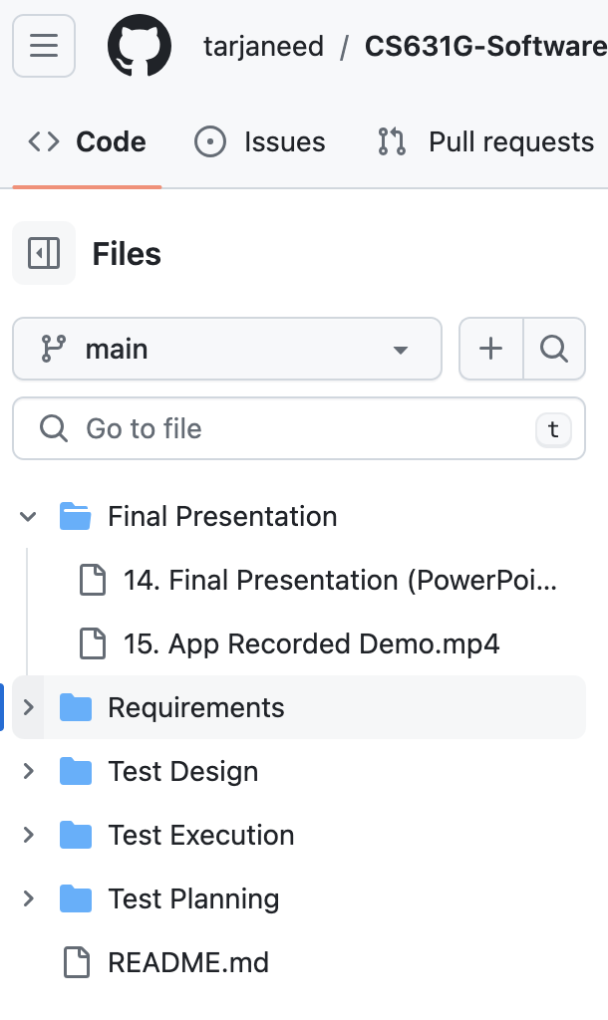
GitHub Repo Folder Structure

Slide 14
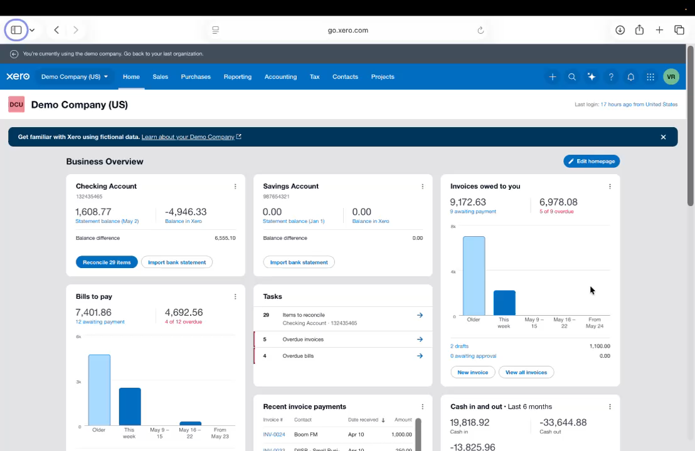
APPLICATION DEMO

Slide 15
Thank You

